Slide 1

Navigation on a ski slope
Marko Bartolić*, Rene Škuljević*, Tomislav Vunak*, Zlatko Stapić
 | University of Zagreb FaFaculty of Organization and Informatics P Pavlinska 2, 42000 Varaždin, Croatia http://www.foi.unizg.hr/
* Students at University of Zagreb, FOI Varazdin

Slide 2
Agenda
Main tasks
Challenges
Problems & solutions
Simulation of algorithms in C#
Questions and discussion

Slide 3
Main tasks
Develop mobile application for navigation while skiing
Recon Snow2 goggles
Problem 1 - which way is skier going
Problem 2 - location on track

Slide 4
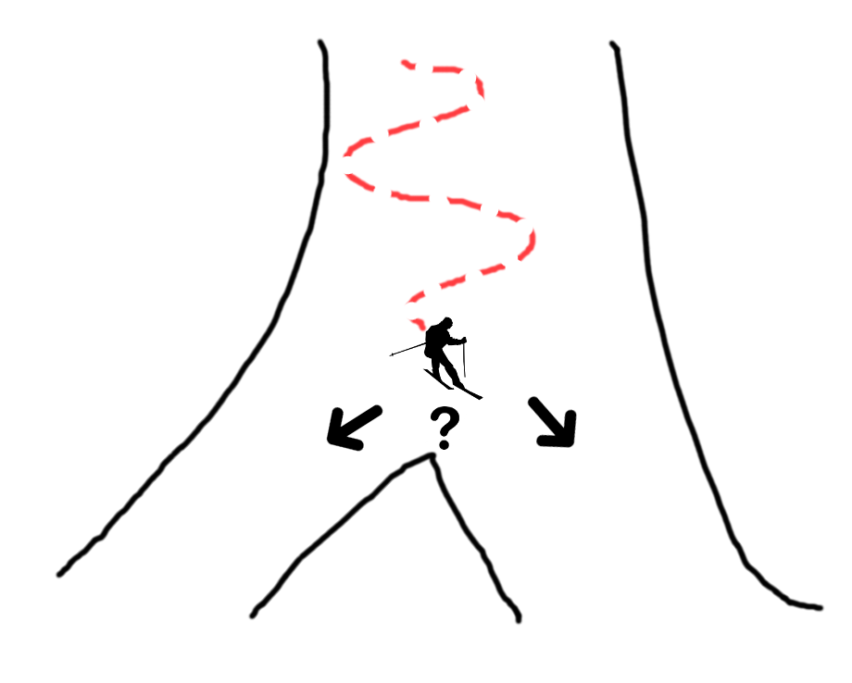
Problem 1 - which way is skier going
Detect in which way the skier is going and depending on the angle of entry in turn show the appropriate arrow

Slide 5
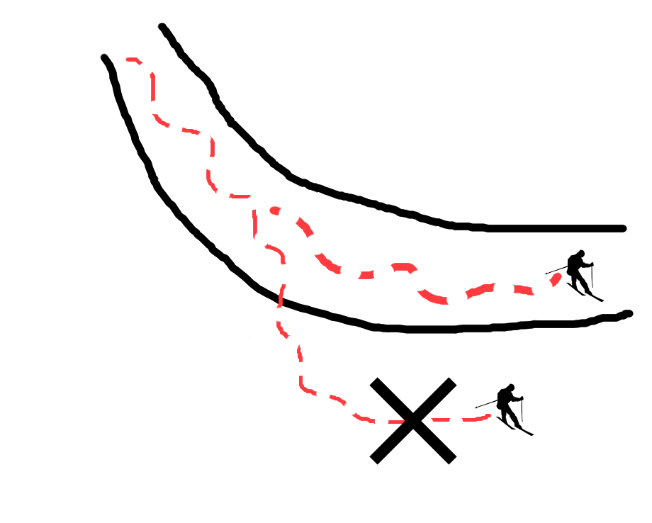
Problem 2 - location on track
Detect if the skier has left the slope

Slide 6
Challenges
Real time navigation
Skiing without interruptions

Slide 7
Problem 1 which way is skier going– solution
Average direction algorithm
Collect extreme left point
Collect extreme right point
Calculate average direction
Assume future user’s location
Calculate angle of entry
50m from turn show arrow of turn

Slide 8
Simulation of algorithms in c# visualization of skiing

Slide 9
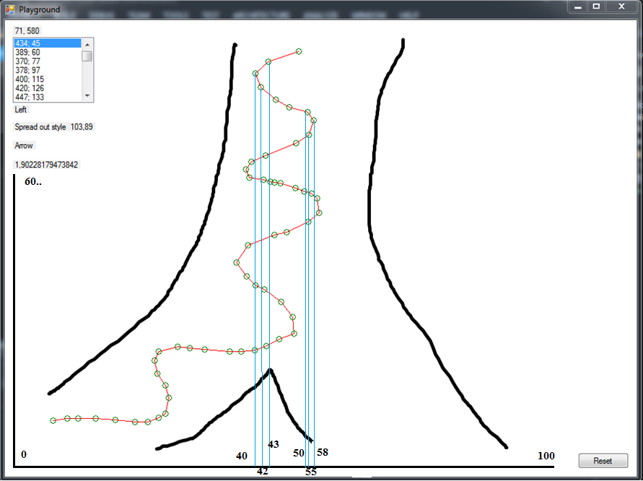
Average direction algorithm Extreme left and right points on X coordinate

Slide 10
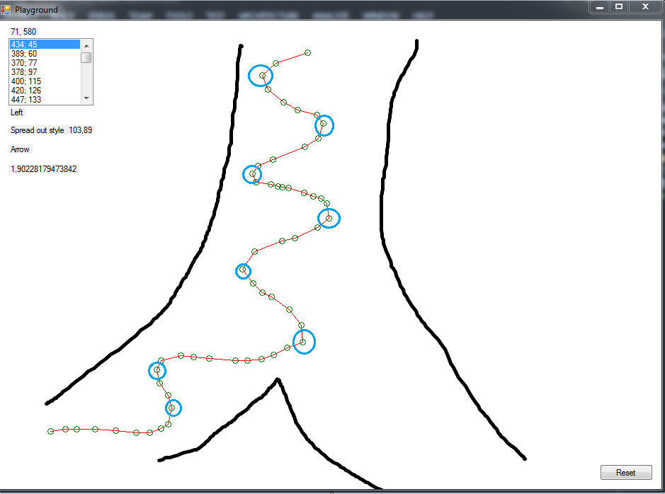
Average direction algorithm Extreme Points taken

Slide 11
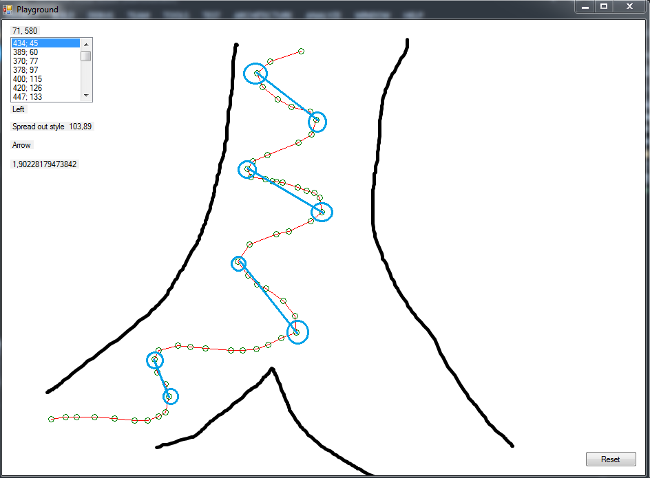
Average direction algorithm Connecting extreme points

Slide 12
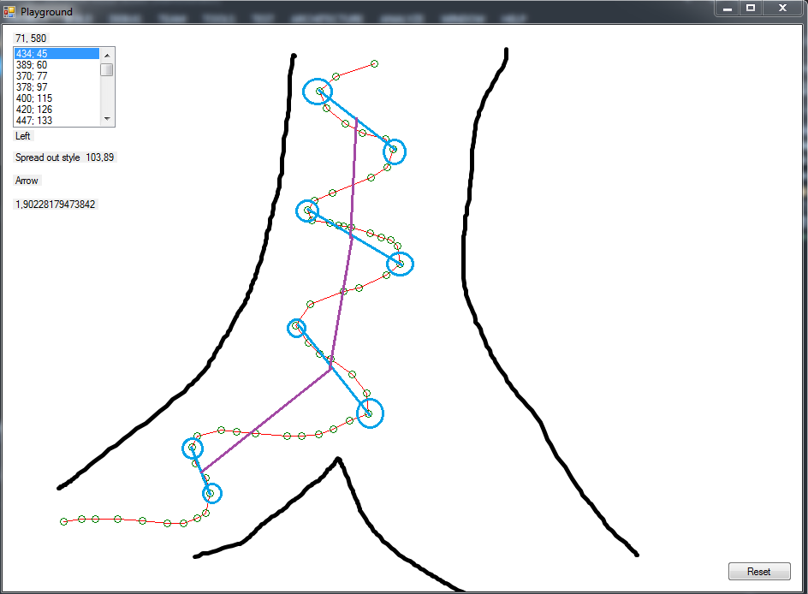
Average direction algorithm Connecting midpoints – relative direction

Slide 13
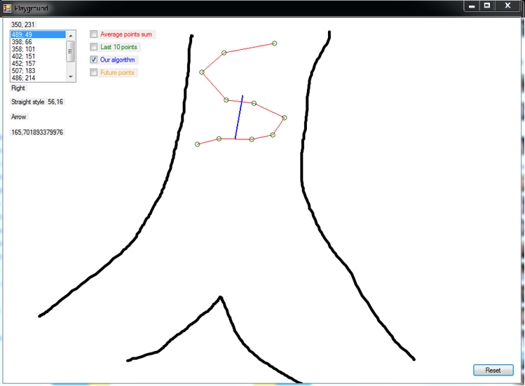
Average direction algorithm Low point frequency

Slide 14
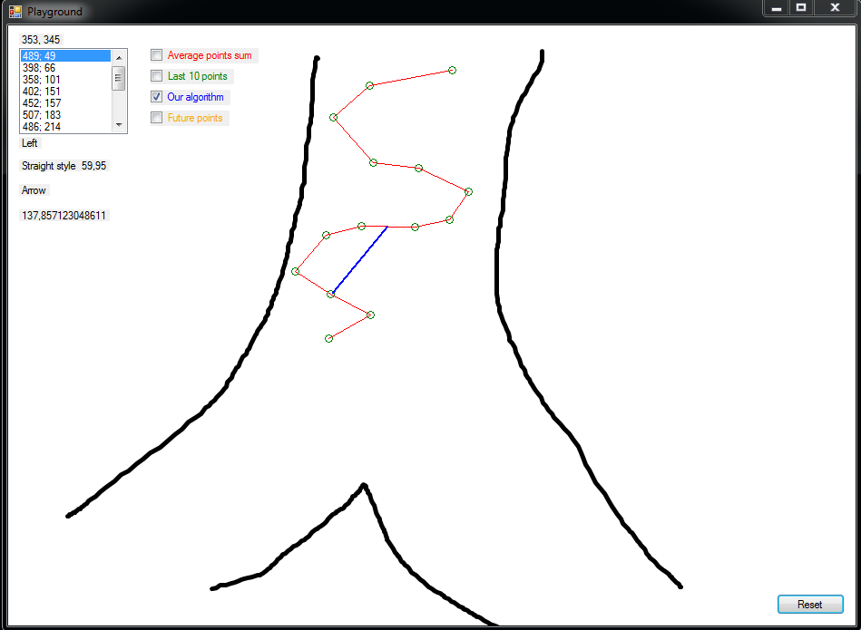
Average direction algorithm Low point frequency

Slide 15
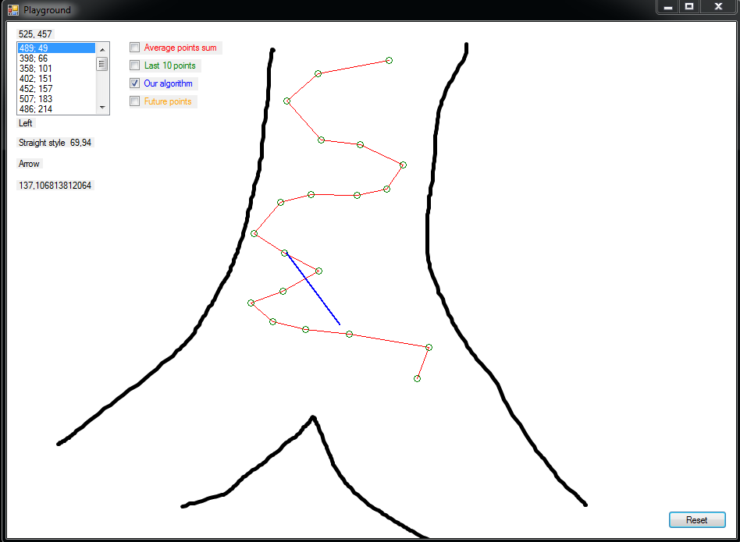
Average direction algorithm Low point frequency

Slide 16
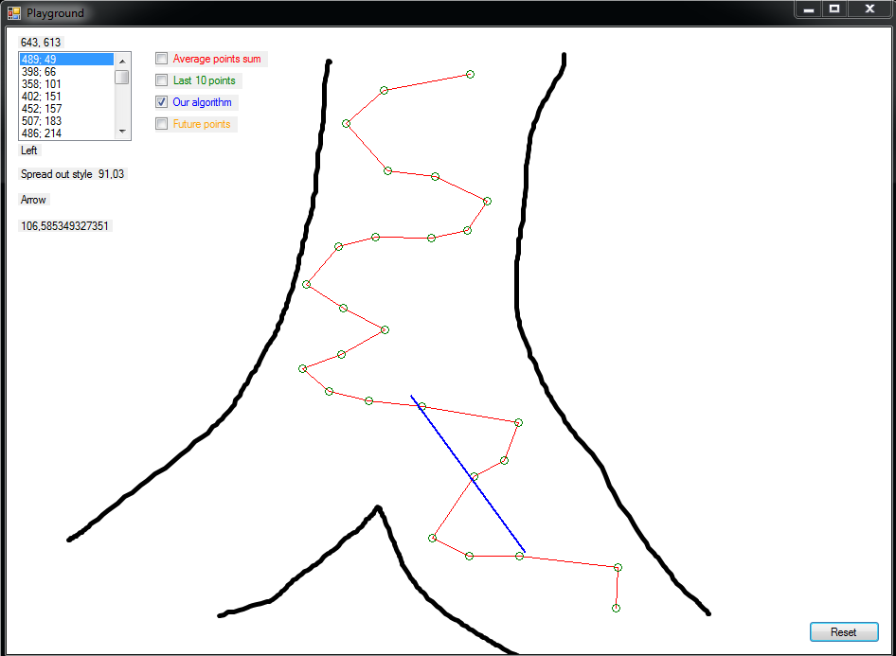
Average direction algorithm Low point frequency

Slide 17
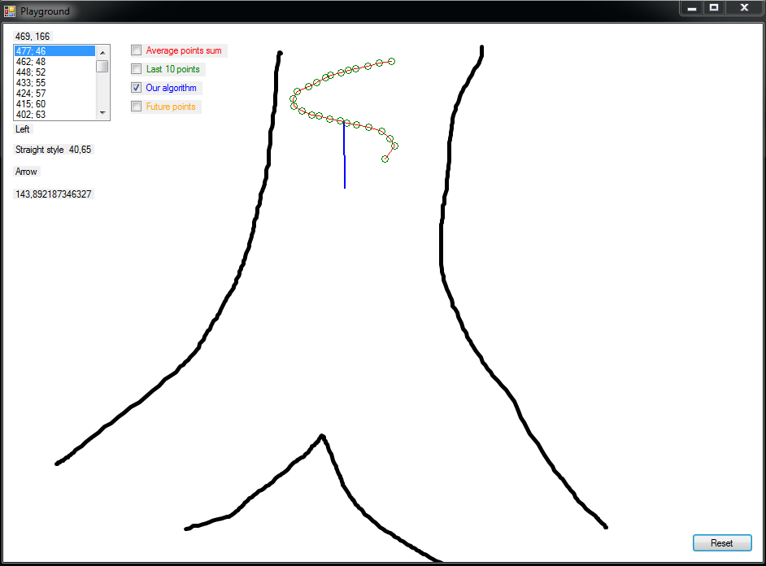
Average direction algorithm High point frequency

Slide 18
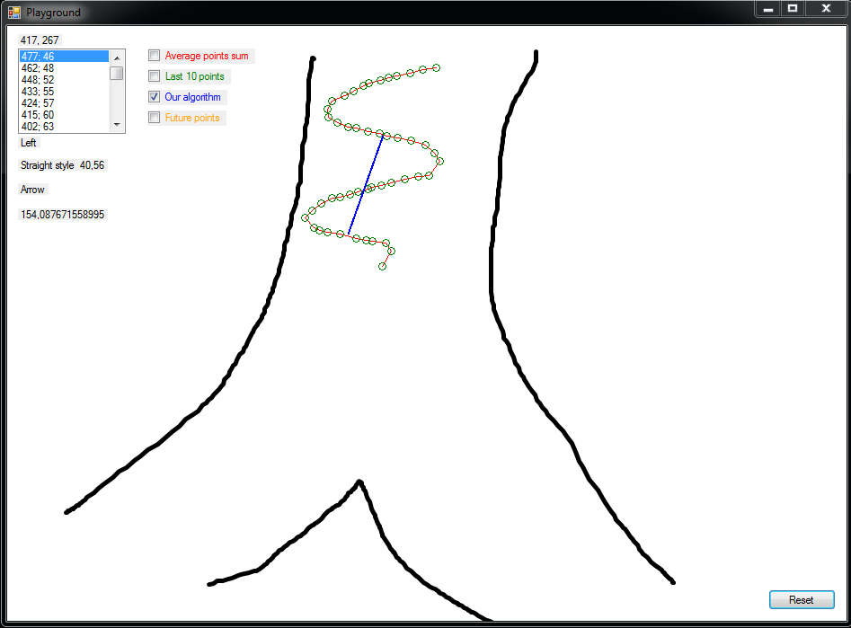
Average direction algorithm High point frequency

Slide 19
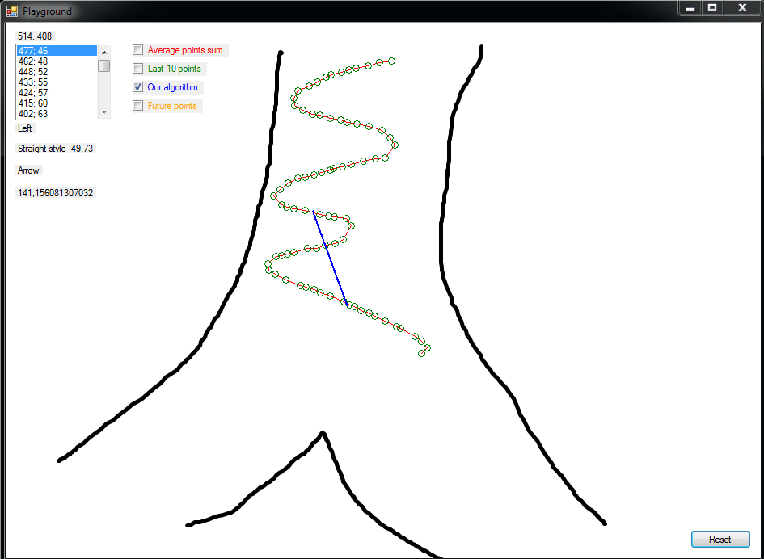
Average direction algorithm High point frequency

Slide 20
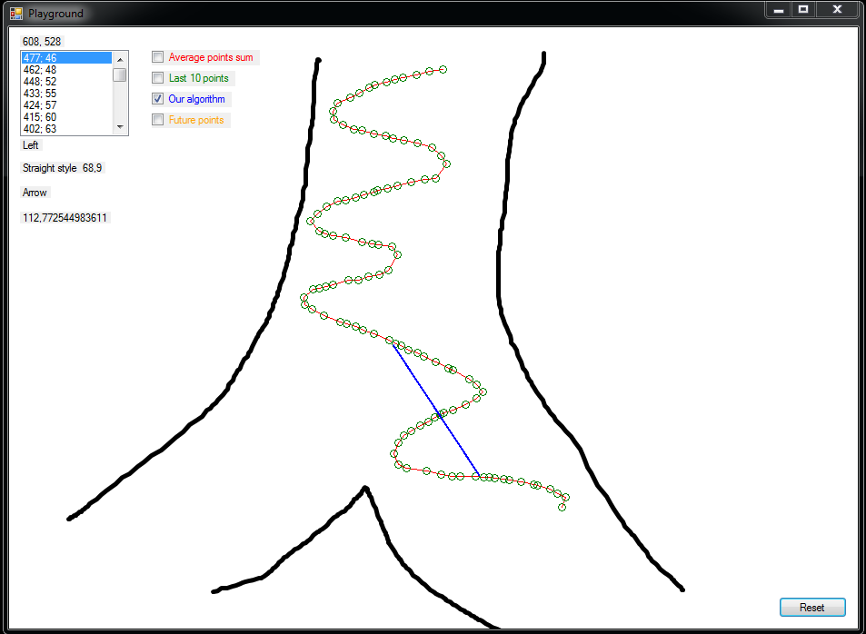
Average direction algorithm High point frequency

Slide 21
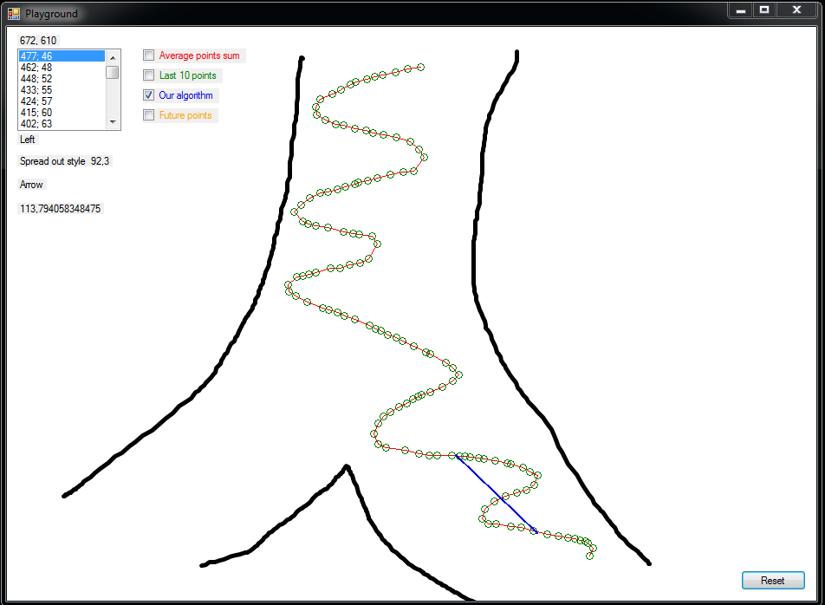
Average direction algorithm High point frequency

Slide 22
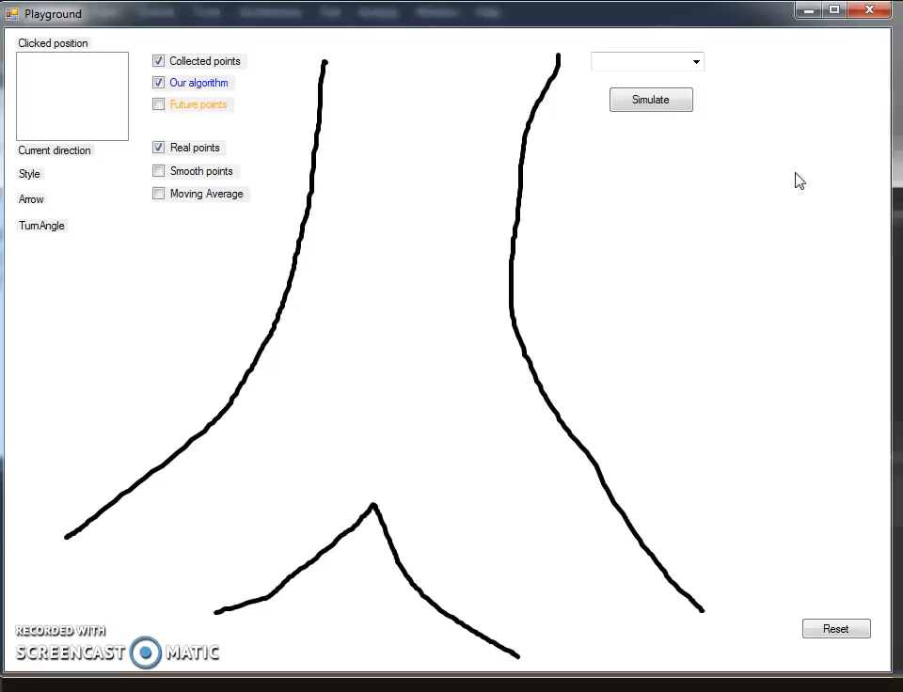
Average direction algorithm - video

Slide 23
Problem 1 Which way is skier going– solution 2
Average points sum algorithm
Uses mathematical alogirthms to calculate average direction based on sum of all points

Slide 24
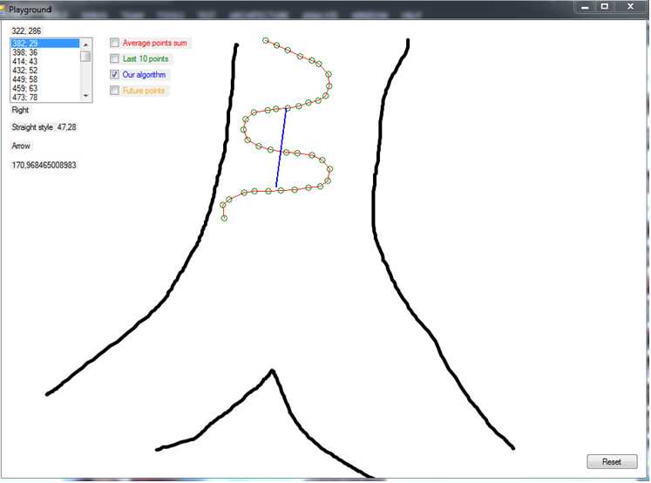
Average direction algorithm

Slide 25
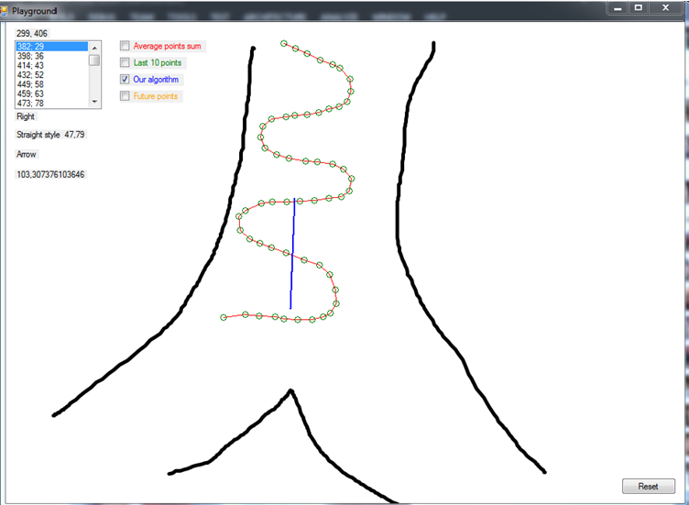
Average direction algorithm

Slide 26
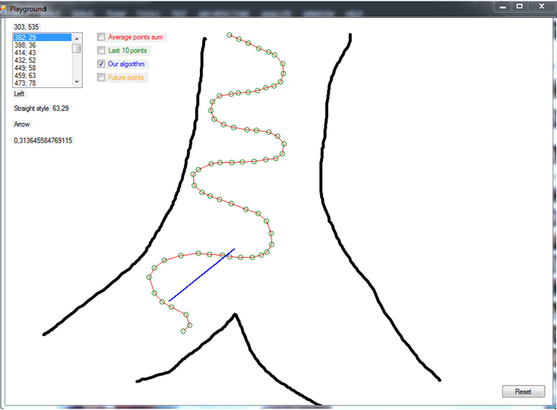
Average direction algorithm

Slide 27
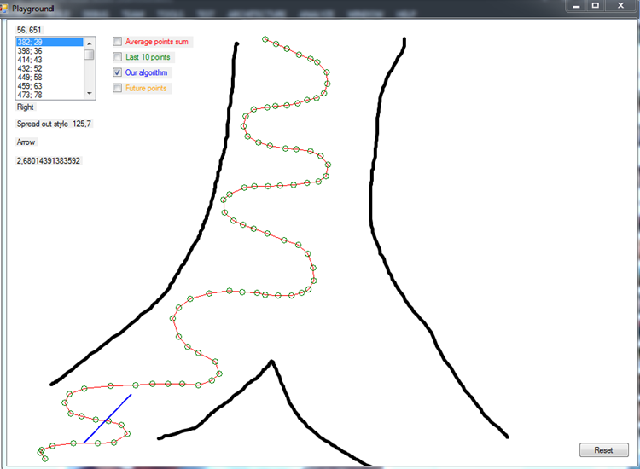
Average direction algorithm

Slide 28
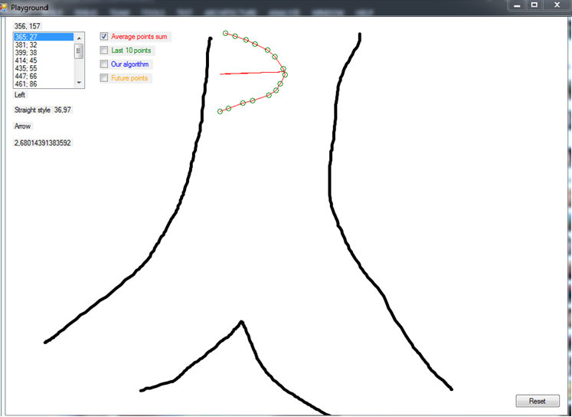
Average points sum

Slide 29
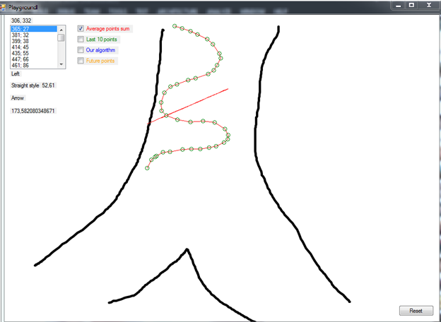
Average points sum

Slide 30
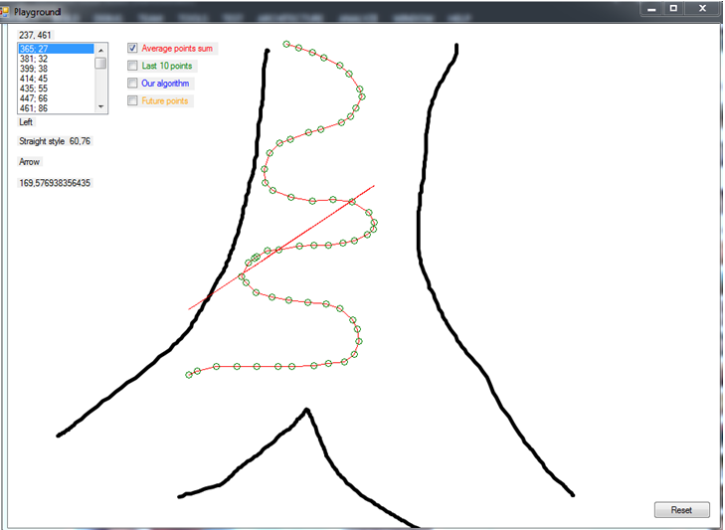
Average points sum

Slide 31
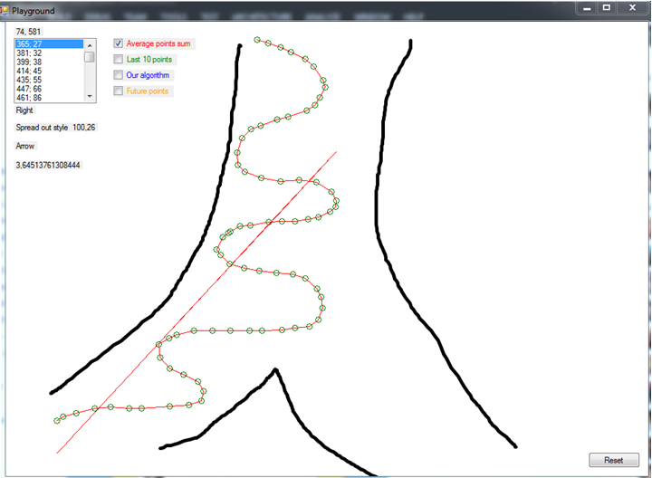
Average points sum

Slide 32
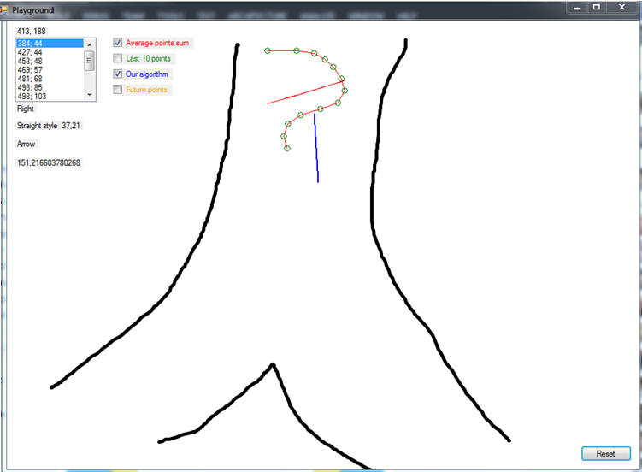
Comparison Average points sum and Average direction

Slide 33
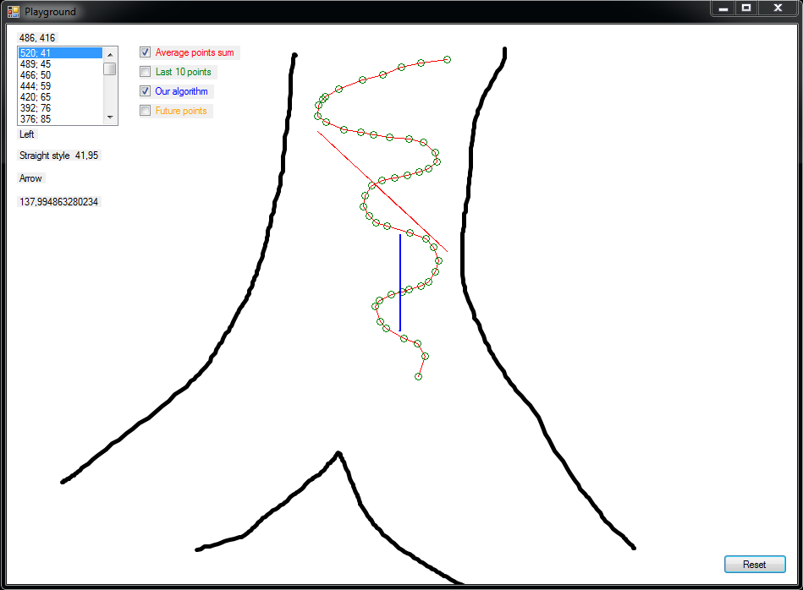
Comparison Average points sum and Average direction

Slide 34
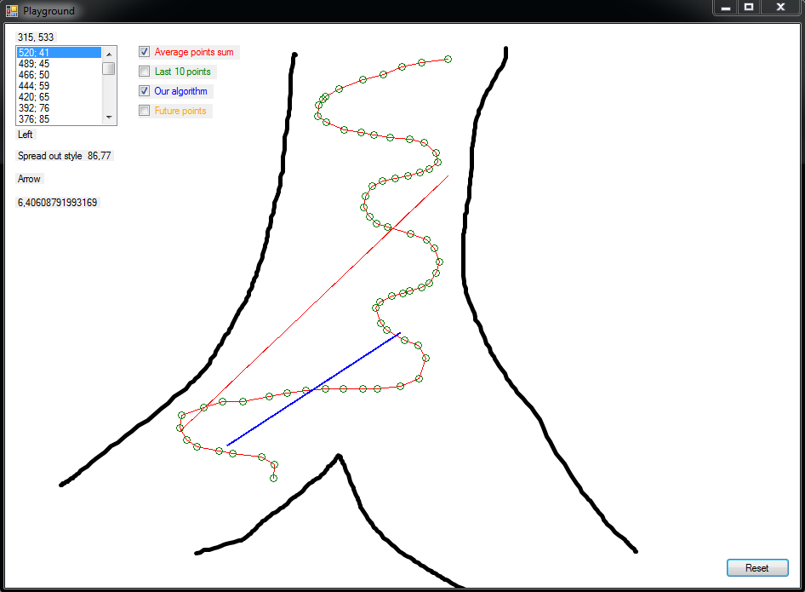
Comparison Average points sum and Average direction

Slide 35
Future position of skier
Determine from which direction skier is entering turn
Affects sharpness of turn
Using previous position of skier it is possible to ”predict” future position
Future points algorithm

Slide 36
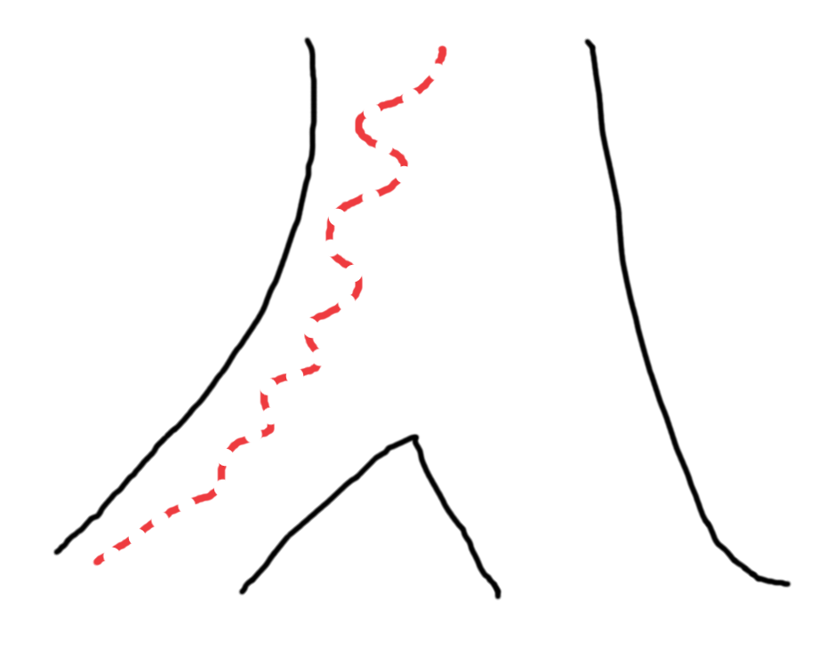
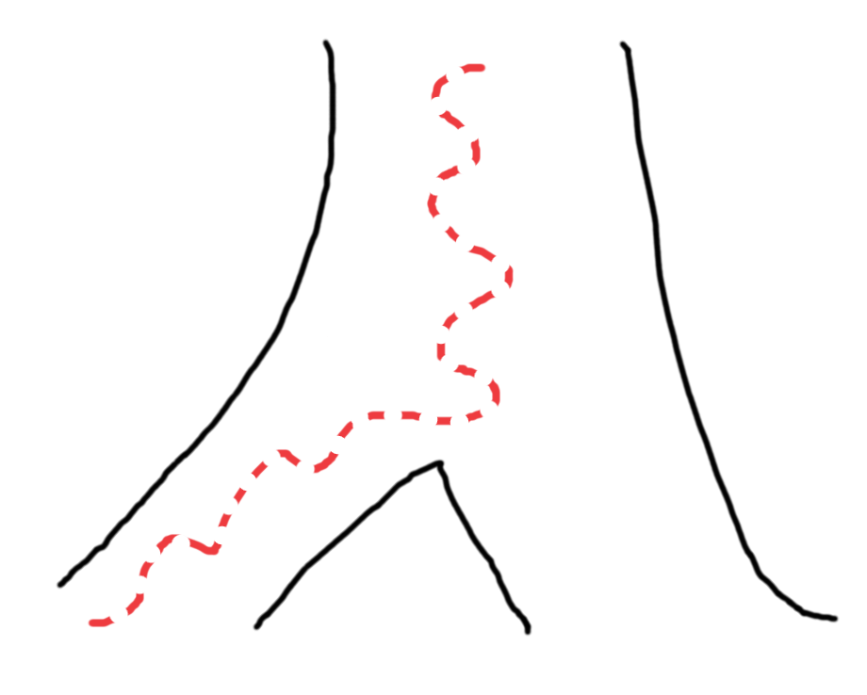
Future position of skier
Required to determine sharpness of turn

Slide 37
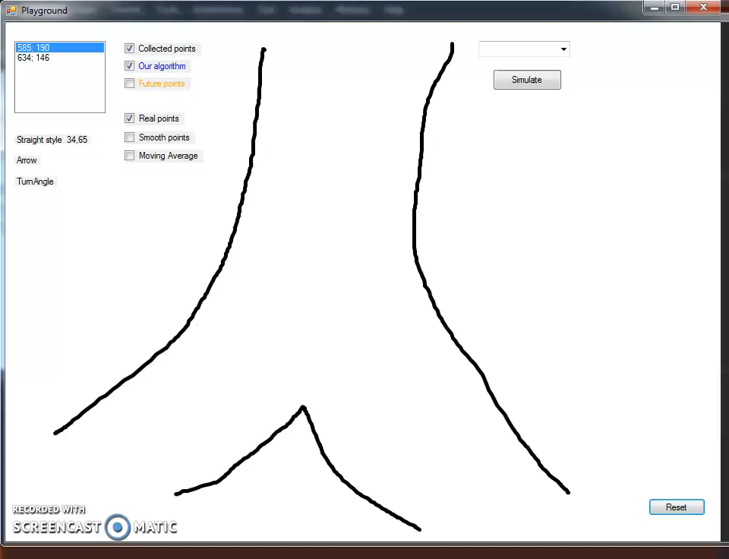
Future Points - video example

Slide 38
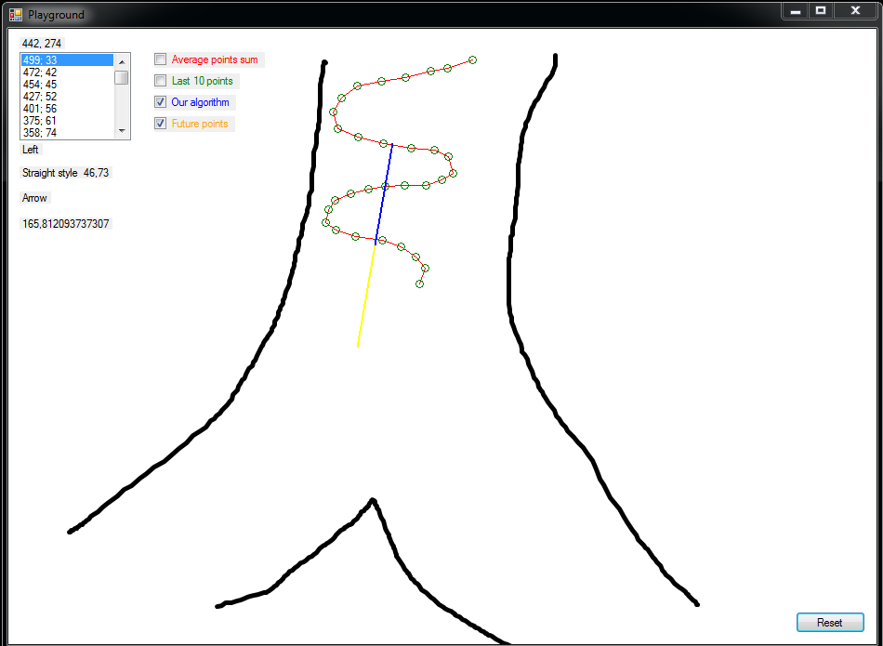
Future points algorithm

Slide 39
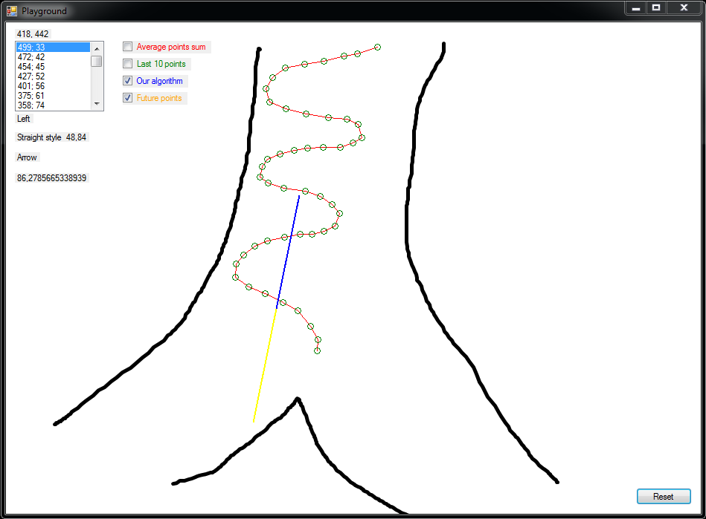
Future points algorithm

Slide 40
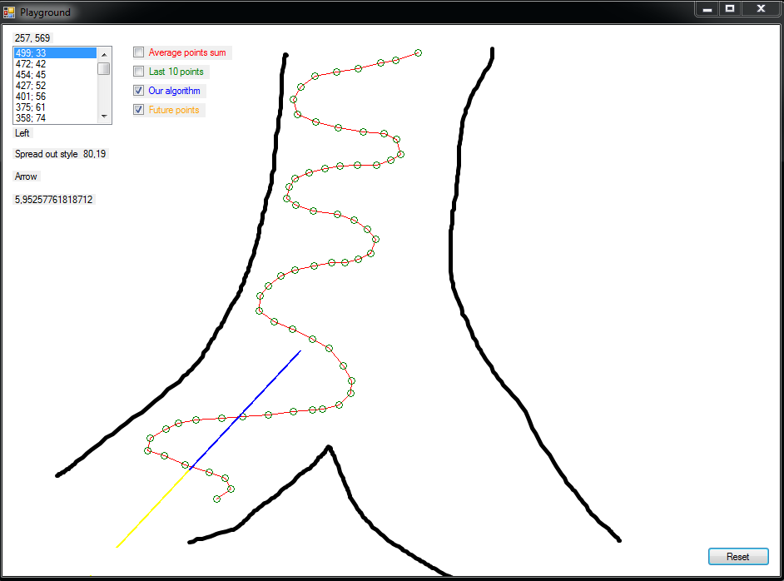
Future points algorithm

Slide 41
Problem 1 Which way is skier going - GPS errors
GPS not accurate – deviation by a few meters
Algorithm doesn’t work properly
Sometimes coordinate Y is taken instead of coordinate X

Slide 42
GPS errors

Slide 43
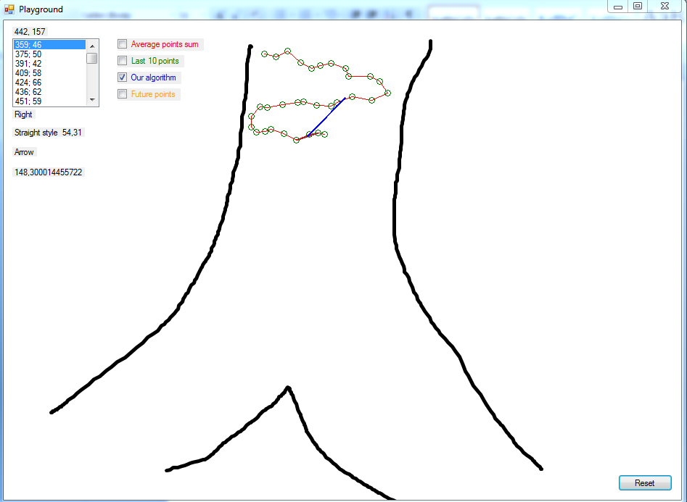
GPS errors

Slide 44
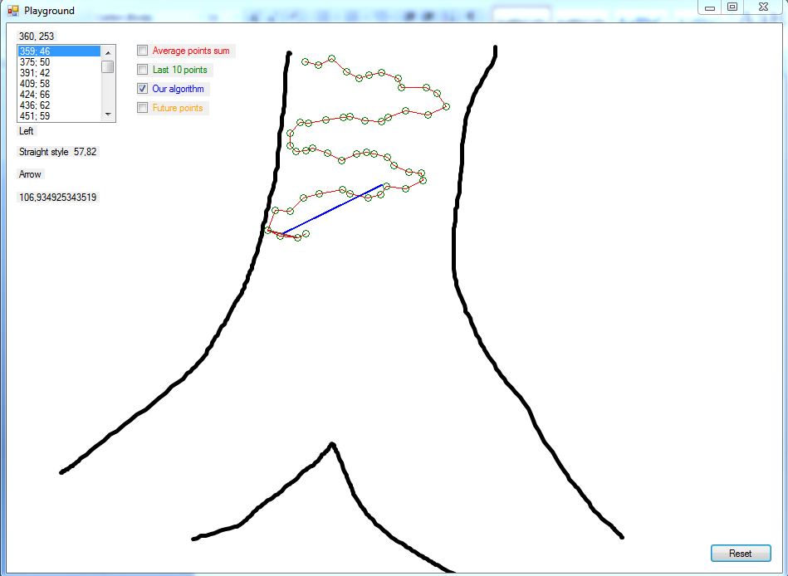
GPS errors

Slide 45
GPS errors – first idea
Translate the whole system (south – northeast, east – west, north – southeast, etc) to a system that would only have SOUTH and NORTH
Coordinate X always available
Mathematically possible to translate the whole system – not applicable
Both the track and the skier’s course need to be separated in ”sectors” and translated separately
Parts (sectors) can not be translated – loss of data integrity
CONCLUSION: not possible to implement

Slide 46
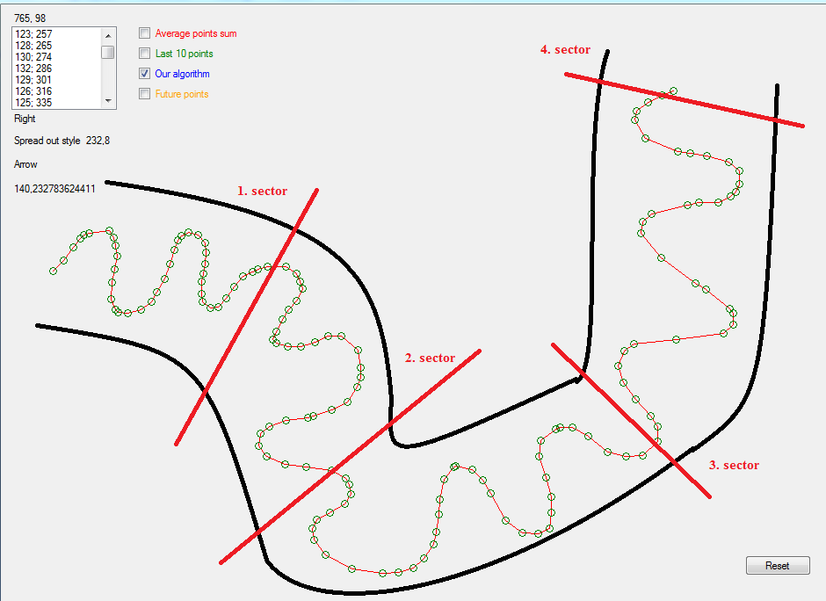
Gps errors First idea Translating coordinate system

Slide 47
Gps errors Second idea Regression analysis
Estimate the relationship between variables – returns average value
Used for prediction
Possible to draw a line between all GPS points
Possible to predict skier’s movement
Problem – not returning expected results

Slide 48
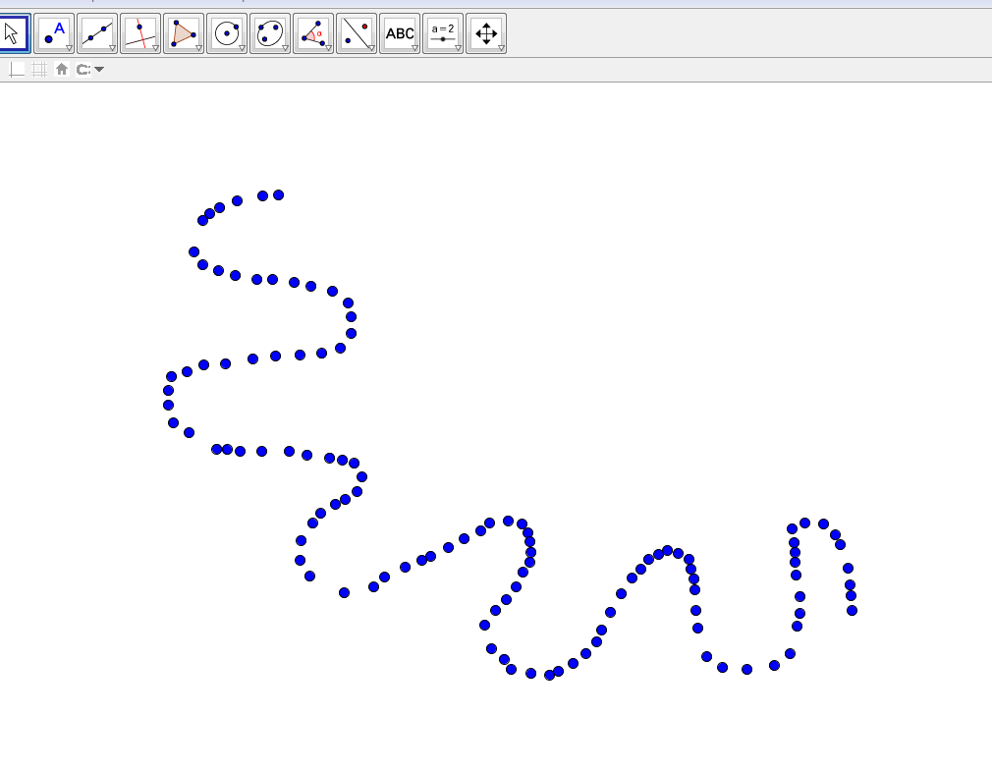
Gps errors second idea Regression analysis - GeoGebra

Slide 49
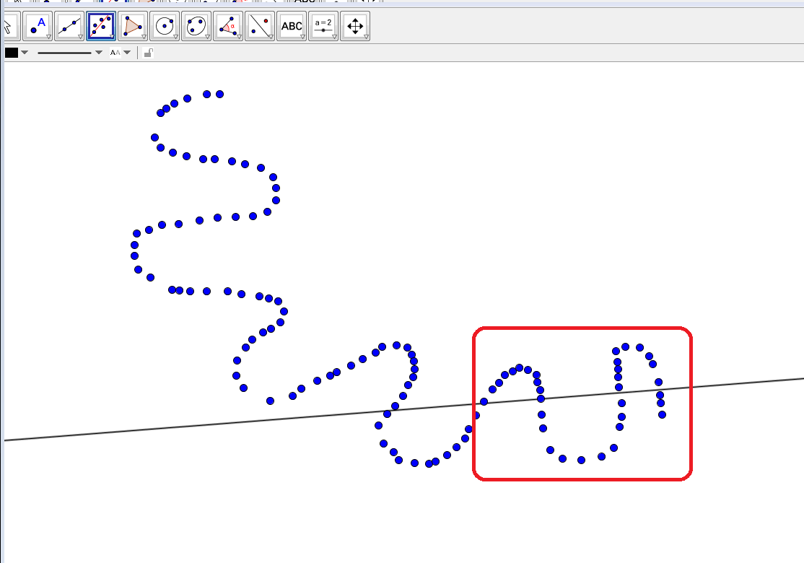
Gps errors second idea Regression analysis - GeoGebra

Slide 50
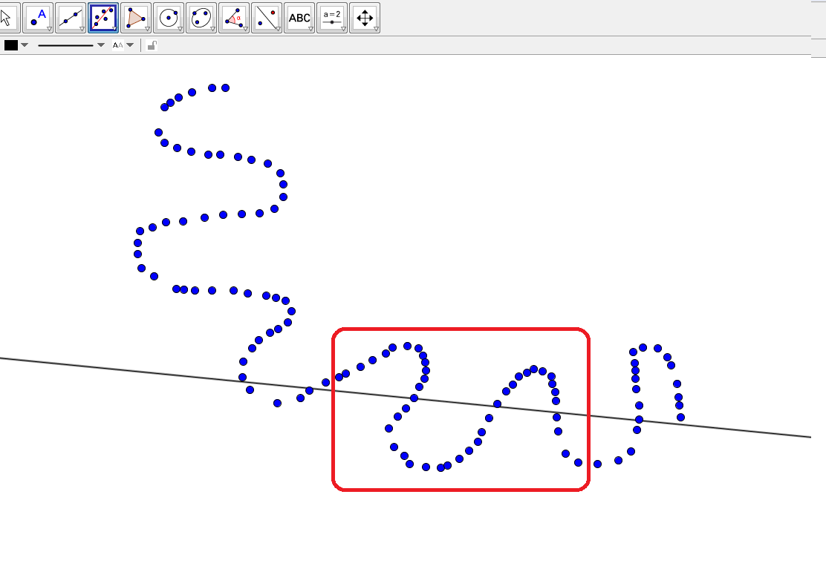
Gps errors second idea Regression analysis - GeoGebra

Slide 51
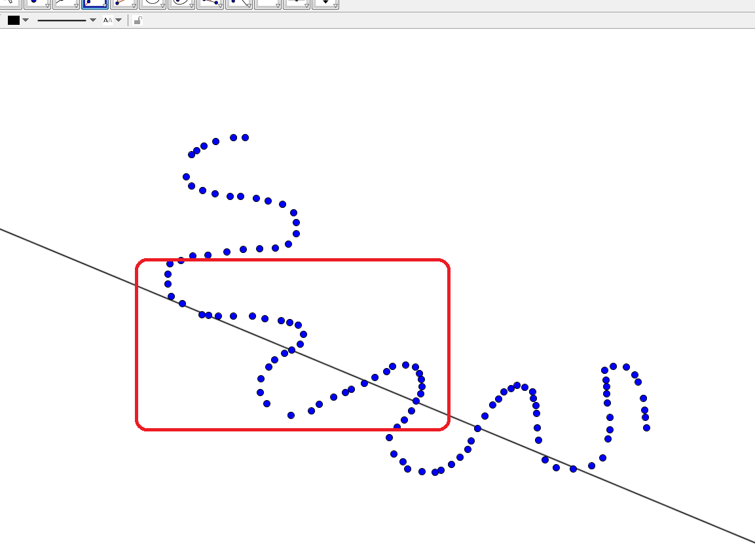
Gps errors second idea Regression analysis - GeoGebra

Slide 52
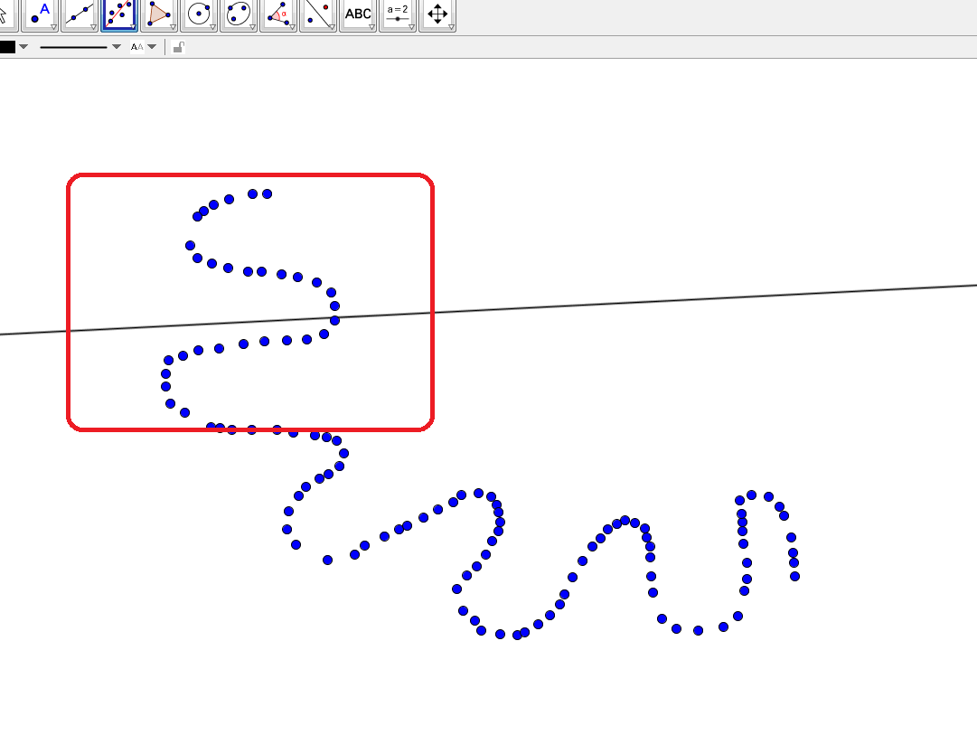
Gps errors second idea Regression analysis - GeoGebra

Slide 53
Gps error Problem solved
Using smoothing algorithms
Smooth point algorithm
Moving average algorithm

Slide 54
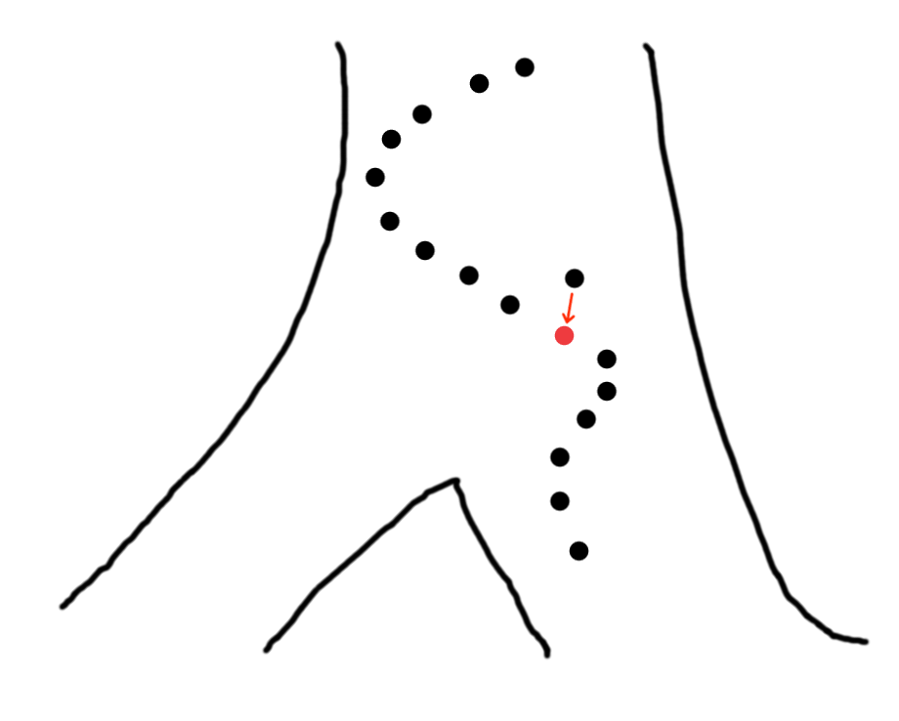
Smooth point algorithm
Smooths skier’s movement
Middle point is ”moved” between its previous and next point

Slide 55
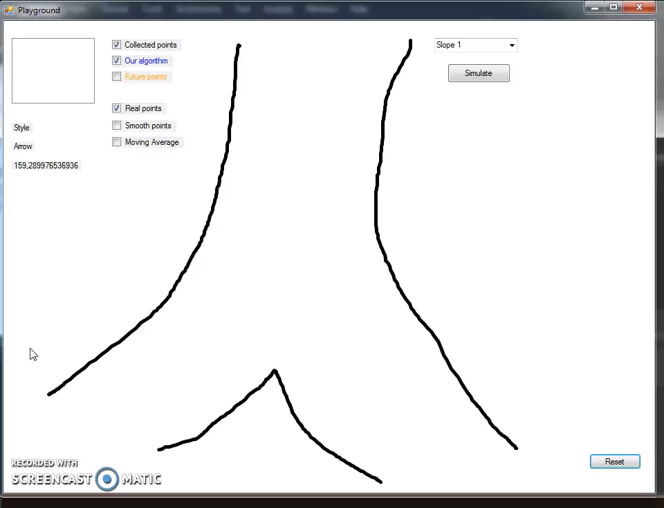
Smooth point algorithm - video

Slide 56
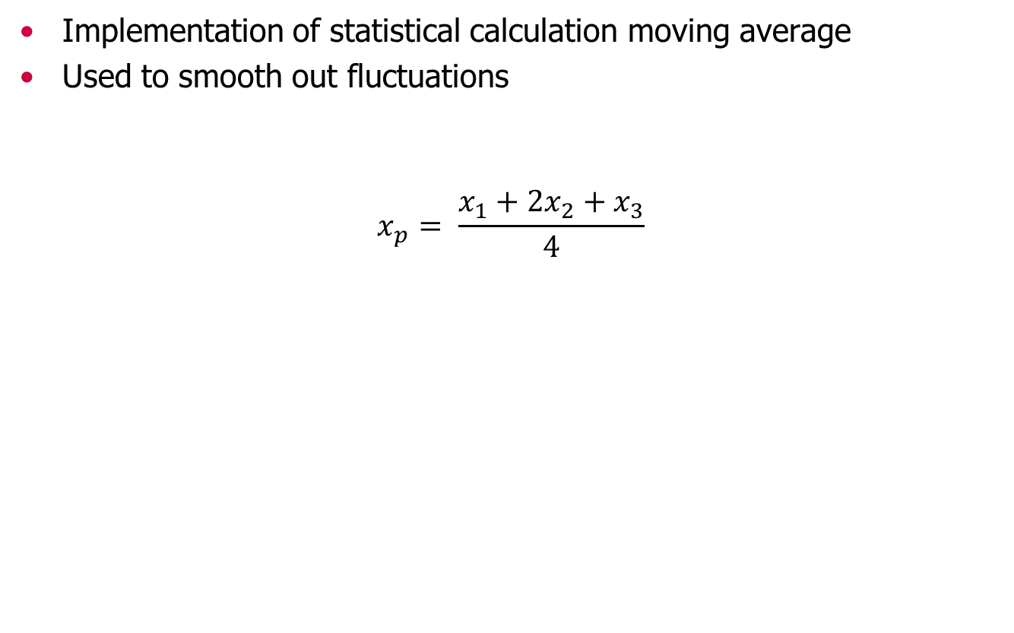
Moving average algorithm
Implementation of statistical calculation moving average
Used to smooth out fluctuations
$$x_{p}= \frac{x_{1}+2x_{2}+x_{3}}{4}$$

Slide 57
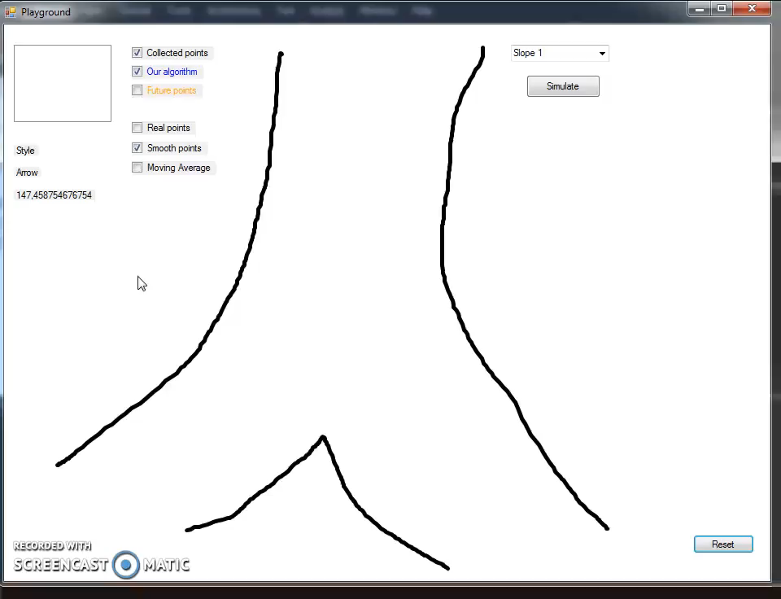
Moving average algorithm - video

Slide 58
Problem 2 Location on track - solution
Compare distance between two sequential points on track and the user’s distance to the next point
If the user’s distance to the next point is greater than the distance between these two sequential points - he is off track
In the meantime, if the user returns back on the track, the message is removed from screen

Slide 59
Location on track Not enough GPS points
Not possible to accurately determine if the skier left the track – not enough GPS points for curves
Server returns only one point – on junction
Possible for skier to still be on track and get a warning about deviating off track
Also possible for skier to be off track and not getting the warning

Slide 60
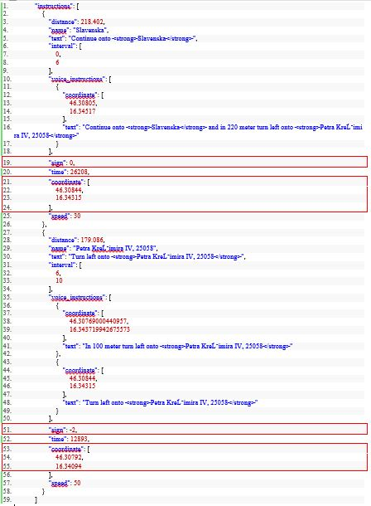
Server response example

Slide 61
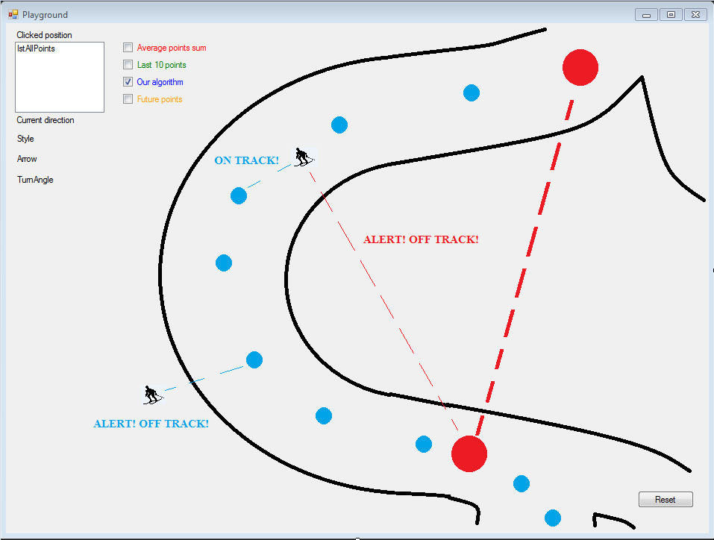
Location on track Not enough GPS points

Slide 62
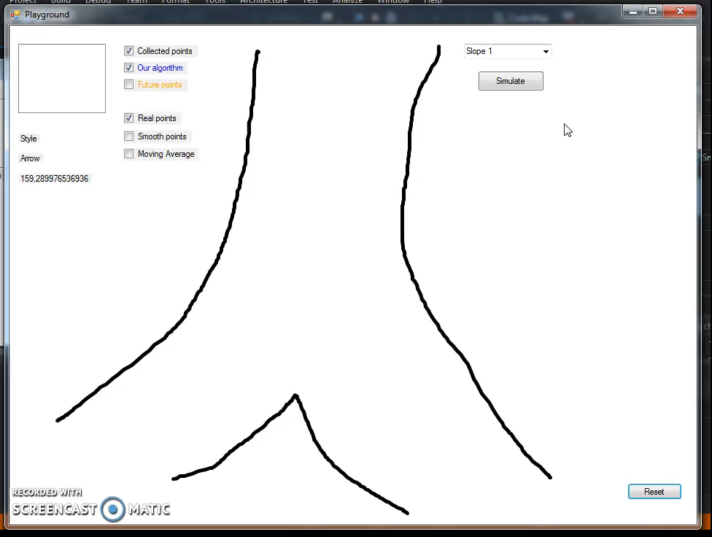
Comparison video Real points, smooth points, moving average

Slide 63

Application video example

Slide 64
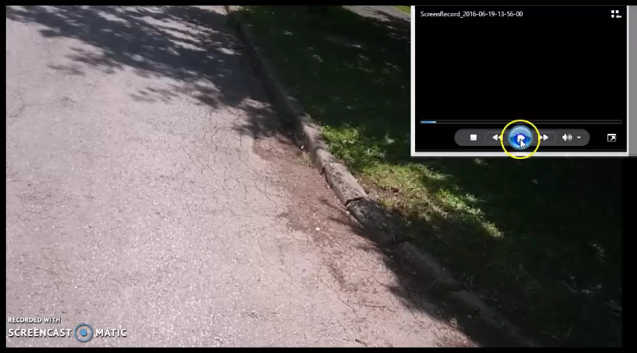
Bicycle simulation & application video

Slide 65

Questions & discussion

Slide 66
Thank you

